Slide 1

Traffic Crash analysis
Pravin Subramanian

Slide 2

Tools & Technology Used:
Language: SQL
Microsoft SQL Server Management Studio
Microsoft Power BI

Slide 3


Dataset Overview
The traffic crash dataset comprises detailed records of every crash, encompassing comprehensive information such as detailed weather conditions, the precise time of each incident, lighting details, road surface conditions, incurred damage costs, the specific street where the crash occurred, and the type of crash. These records span occurrences in Chicago and its nearby areas, spanning from March 3, 2013, to December 2, 2023.

Slide 4
Python vs Power BI
Based on the provided problem statement to process 785,871 volume of data, I chose SQL and Power BI instead of Python. The reason are
Power BI provides a user-friendly interface and allows for efficient chart creation, requiring considerably less time compared to Python and its libraries.
Power BI simplifies the data analysis process with drag and drop functionality.
Power BI offers cloud-based options, allowing for convenient access to reports and dashboards from anywhere.
Additionally, the combination of SQL Server with Power BI provides high scalability, allowing for the storage of substantial volumes of data.

Slide 5
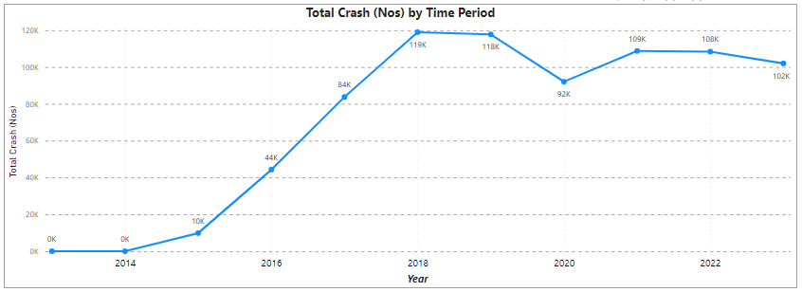
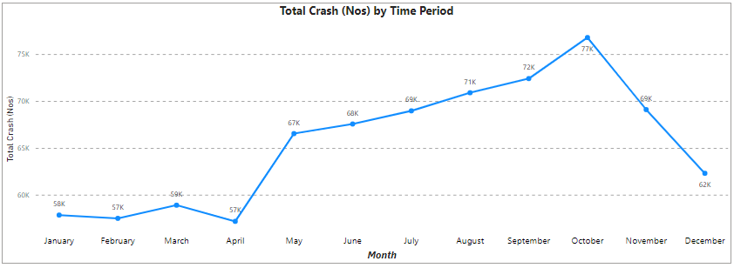
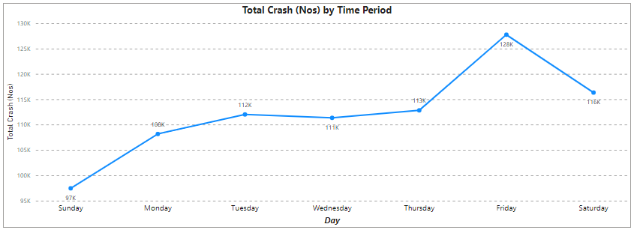
Qn.1 - Is there a correlation between the time of year/week/day and the occurrence of car crashes?
Ans:- Yes, there is a clear connection between the time of year, week, and day, and car crashes. Over the years, crashes gradually increased, reaching a peak in 2018, and remaining relatively stable except for 2020, possibly influenced by the COVID-19 lockdown. October consistently records the highest number of crashes, while the first four months have the lowest. Additionally, Fridays consistently report the highest crash numbers, whereas Sundays consistently have the lowest. These findings suggest that specific times significantly impact crash frequencies, opening avenues for further analysis to gain more insights.
5

Slide 6
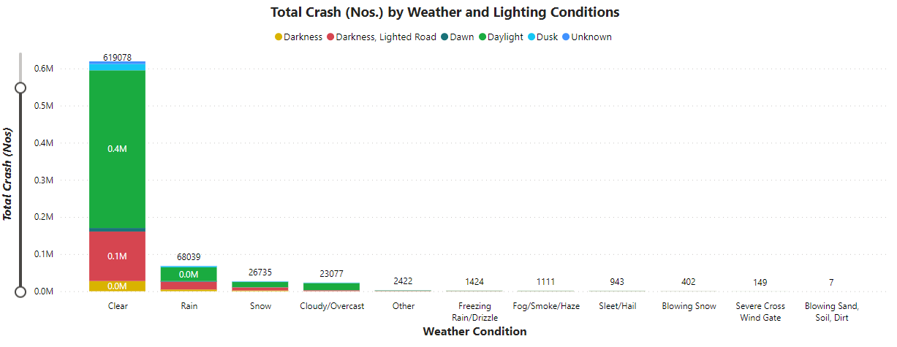
Qn.2 - Is there a causal relationship between wet weather conditions and the number of car crashes?
Ans:- No, wet weather conditions do not seem to have a direct impact on the number of car crashes. The chart numbers suggest that weather and lighting conditions play a limited role in crashes. Over 600,000 crashes took place during clear weather conditions, notably 400,000 during daytime—the highest incidence compared to other conditions. In contrast, fewer than 70,000 crashes occurred during rainy weather. Blowing sand, soil, and dirt weather conditions had the lowest occurrence, with only seven reported crashes. However, there is an indirect causal relationship between wet weather and the number of car crashes, as the crash numbers significantly reduced during rainy and snowy weather. This might be attributed to people avoiding vehicle usage during wet weather conditions.
Traffic Crash Analysis
6

Slide 7
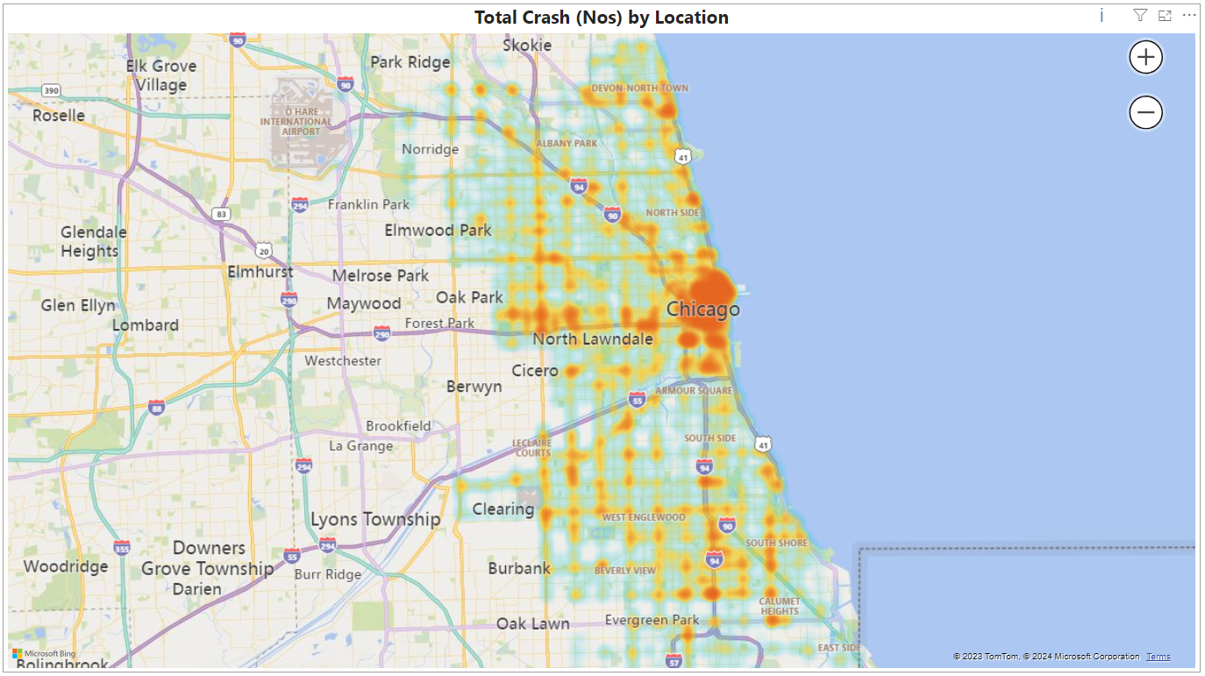
Qn.3 - Identify key areas where most traffic crashes occur and identify potential safety measures that should be implemented in these areas to minimise accidents.
Ans:- The map clearly illustrates that the majority of crashes happen on Chicago streets, with fewer incidents in nearby areas. This hints at the impact of high population density and heavy traffic, potentially contributing to congestion and crashes. However, the absence of data indicating traffic volume during crashes makes pinpointing the exact reasons challenging. To address this, implementing new traffic rules, designating restricted areas, creating slow zones, establishing 'No Horn' zones, and enforcing speed limits in school zones could be effective measures to reduce accidents.
Traffic Crash Analysis
7

Slide 8
Additional Key Findings
Crash based on road surface conditions and speed category.
People Injured in Each Crash
Total Crash (Nos) based on Damage Costs

Slide 9
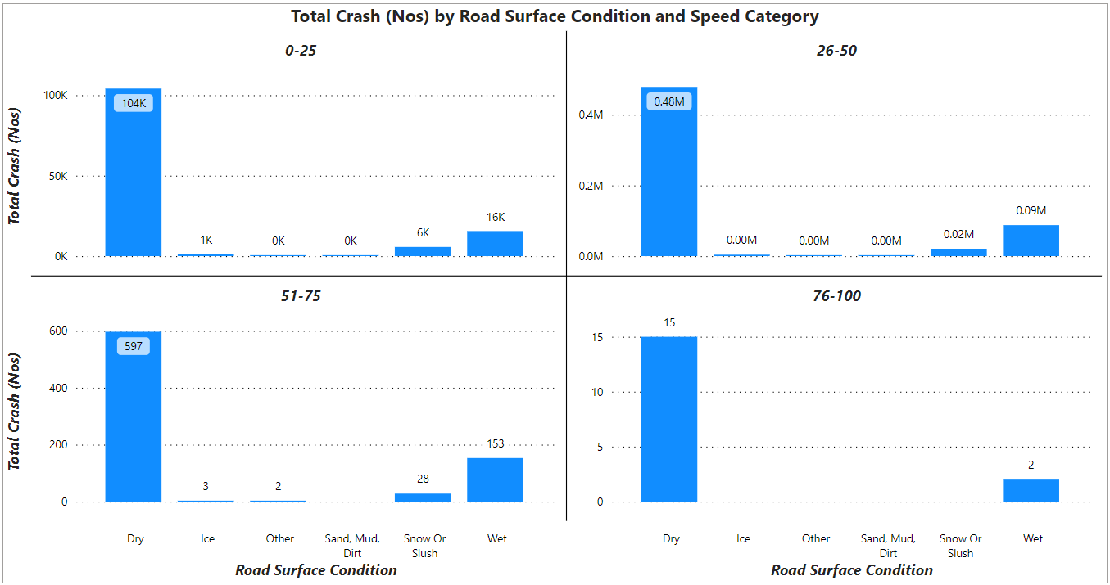
Crash based on Road Surface Condition and Speed Category
The graph shows that most crash incidents fall into the 26-50 speed category, with around 0.4 million occurring on dry roads. Surprisingly, road conditions like wet, icy, and sandy surfaces have significantly fewer incidents compared to dry roads. The high-speed category also has remarkably low numbers. Hence, there seems to be no clear link between speed category and adverse road conditions regarding the number of crashes.
Traffic Crash Analysis
9

Slide 10
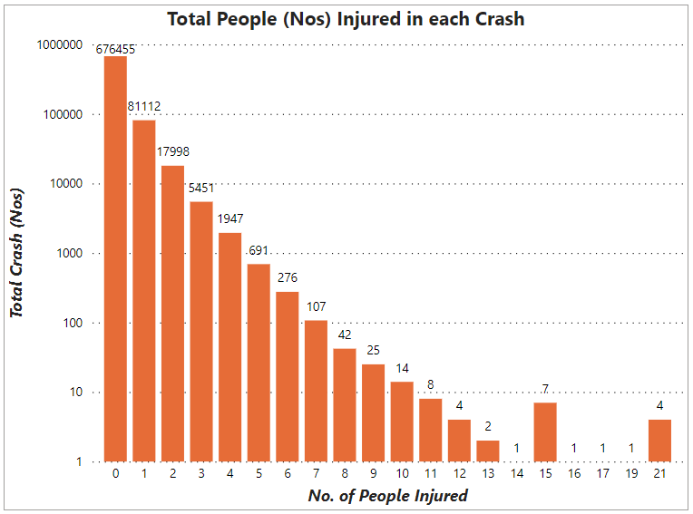
People Injured in each Crash
The graph highlights that the majority of crash incidents resulted in fewer or no injuries, indicating that most crashes were relatively minor. Only four incidents were associated with major injuries, where a total of 21 people were injured across these four crashes.
Traffic Crash Analysis
10

Slide 11
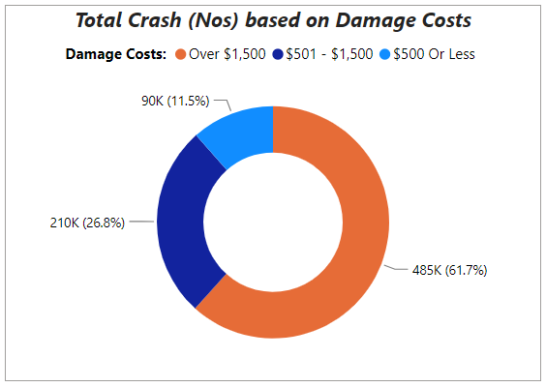
Total Crash (Nos) based on Damage Costs
The chart shows a significant trend, with over 60% of crashes incurring damages exceeding $1500, indicating a substantial financial impact. In contrast, less than 12% resulted in costs of $500 or less. Although damage costs are high, the number of people injured remains low. This suggests that congestion in Chicago streets is a primary factor contributing to high crash numbers. To address this issue, enhancing and enforcing existing traffic rules, along with implementing new regulations, could be considered to reduce crash occurrences.

Slide 12
Testing
To verify the accuracy of chart numbers, I conducted a sanity check by comparing the data in the SQL table with the chart values
Additional testing methods can be considered such as;
Implementing automated testing scripts
Utilizing data profiling tools

Slide 13



Summary
In summary, the data shows that most crashes happen in crowded places, especially in Chicago streets on Friday afternoons and during school leaving times. However, the absence of data on street congestion and traffic volume during crash times makes pinpointing exact reasons challenging. To enhance road safety and reduce crashes, I recommend improving traffic signals and implementing no-entry zones in highly congested streets.

Slide 14


THANK YOU
Pravin Subramanian

